Slide 1
MVP Presentation <AvengersJIS>
Idea Title : NovaCare – Post-Discharge Care Intelligence Platform
Team Captain Name : Naman Sharma
Team members Names : Naman Sharma, Koustav Paul, Puspita Jana, Kasturi Dewan
College Name : JIS College Of Engineering

Slide 2
Where NovaCare Began
Imagine leaving the hospital with pages of instructions but not fully understanding what comes next.
For many patients, this is reality.
They return home confused about medicines, warning signs,and discharge instructions—simply because of language barriers.
Their families try to help,but they struggle to understand too.
And sometimes, that confusion leads to serious complications.

Slide 3
<<NovaCare>>
Problem Statement
Solution Description
1 in 5 patients in India are readmitted within 30 days after hospital discharge
74 Cr ABHA IDs exist but ZERO post-discharge AI intelligence uses them
🇮🇳 India has 27 Cr+ chronic NCD patients (Heart Failure, Diabetes, COPD, CKD)
Language barriers prevent patients from understanding discharge instruction.
60% of patients stop their medication within 30 days due to lack of understanding.
Current post-discharge monitoring costs just ₹120 yet remains completely unused
This is not an exception — it is the median story of every discharged patient in India
CareBridge · 4-agent AI · 30-day post-discharge monitoring
Agent 1 — Discharge Translator FHIR → care plan · 12 languages · WhatsApp/IVR · Day 0
Agent 2 — Daily Pulse Daily check-ins Days 1–30 · voice + text · NLP symptoms
Agent 3 — Risk Orchestrator LightGBM risk scoring · real-time · auto-escalation
Agent 4 — Continuity Bridge Medication gaps · UHI bookings · record sync
🟢→🟠→🔴 Escalation: AI nudge → Teleconsult → Hospital + 108
India Stack: ABHA · ABDM · eSanjeevani · UHI
Zero app · WhatsApp + IVR only · 333x ROI

Slide 4
<<NovaCare>>
Uniqueness / Innovativeness
Business Impact
Vernacular AI for Indian languages – translates complex medical instructions into simple local language for better understanding
Stateful 30-day multi-agent architecture — unlike one-time discharge apps, NovaCare's LangGraph-powered agents maintain full patient context and symptom trends across all 30 days continuously
Self-improving AI — Day 30 ABHA outcome check automatically triggers weekly LightGBM model retraining via AWS SageMaker, meaning the system gets smarter with every patient cohort
Real-time risk prediction with action – not just alerts, but automatic escalation and teleconsultation
Seamless integration with India Stack (ABDM, ABHA, eSanjeevani) – no need for new apps or systems
17–28% reduction in 30-day readmissions
95% automation of routine nursing check-ins
Plug-and-play ABDM · any hospital onboards in 24 hrs
333x ROI · ₹120 monitoring vs ₹40,000+ readmission
1 prevented ICU readmission = 6+ months of CareBridge
3 Revenue Streams: · Private Hospitals — SaaS ₹150/patient/month · PMJAY/NHA — ₹250/episode outcome-linked · Pharma/Insurers — RWE data licensing
1.5L Ayushman Mandirs reachable · same platform · zero extra cost
1 API key · any NABH hospital goes live instantly · no custom dev needed

Slide 5
<<NovaCare>>
Technical Design and architecture
ABDM FHIR
Agent 1
Patient & Family
Agent | Name | Trigger | What It Does | Output
A1 | Discharge Translator | ABDM · Day 0 | FHIR → 12 languages | Care Plan
A2 | Daily Pulse | Daily · Days 1–30 | WhatsApp/IVR + NLP | Data Captured
A3 | Risk Orchestrator | Real-time | LightGBM · auto-escalate | Intervention
A4 | Continuity Bridge | Event | Medication + UHI sync | Care Loop
Agent2
Agent3
Escalation
Day 30 ABHA Outcome Check
SageMaker
Optimized Model
** Use additional slides to include other relevant details, as required.

Slide 6
<<NovaCare>>
Scalable / Reusable
Roadmap
MVP live in 24 hours using existing AWS + India Stack — no new infrastructure
2 hospitals → 1.5L Ayushman Mandirs — same platform, national scale
FHIR standard — globally interoperable, SAARC expansion ready
Self-improving weekly — SageMaker retrains automatically with every cohort
One API key — any NABH hospital activates instantly, zero custom development
4 modular agents — deploy all or just one based on hospital's existing setup
3 revenue models — SaaS / PMJAY outcome-linked / insurer RWE, same platform
Any condition, any language — extend via FHIR templates + IndicNLP, no code change
1
2–3 hospitals~1000
patientsMonth 1–3
2
20 hospitalsState-wideMonth 4–6
3
Govt. deployABDM integrationMonth 7–12
4
Hospitals +Insurers + RuralYear 2+

Slide 7
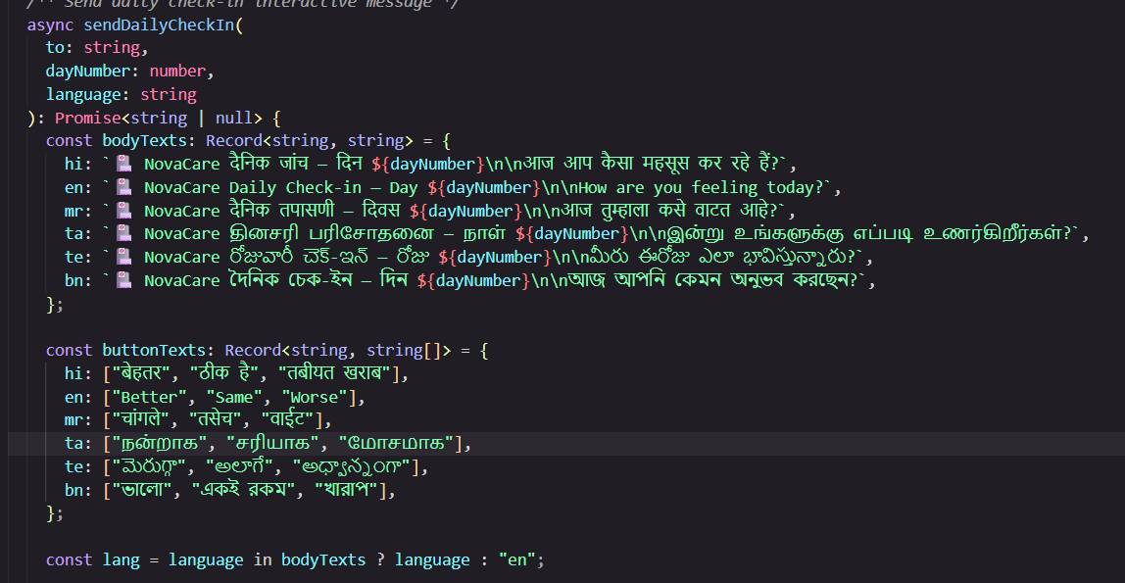
<<NovaCare>>
<<NovaCare>>
Our Code Snip
Our Code Links
Our entire code has pushed on Github
Github Link :
https://github.com/Naman12678/Novacare-platform

Slide 8
Thank you

